Slide 1


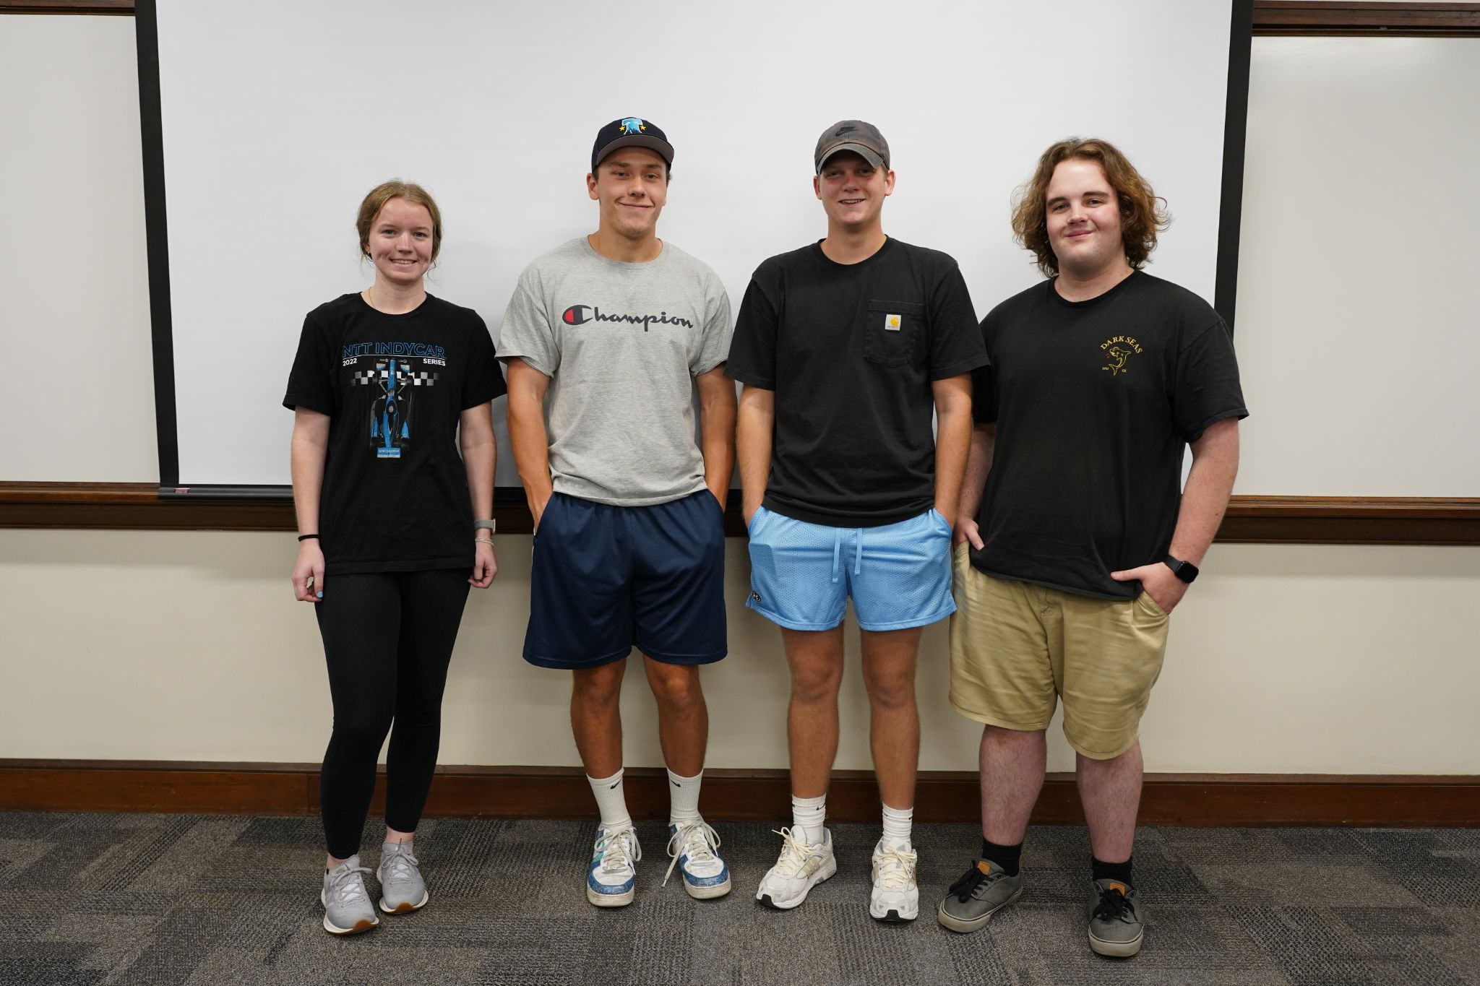
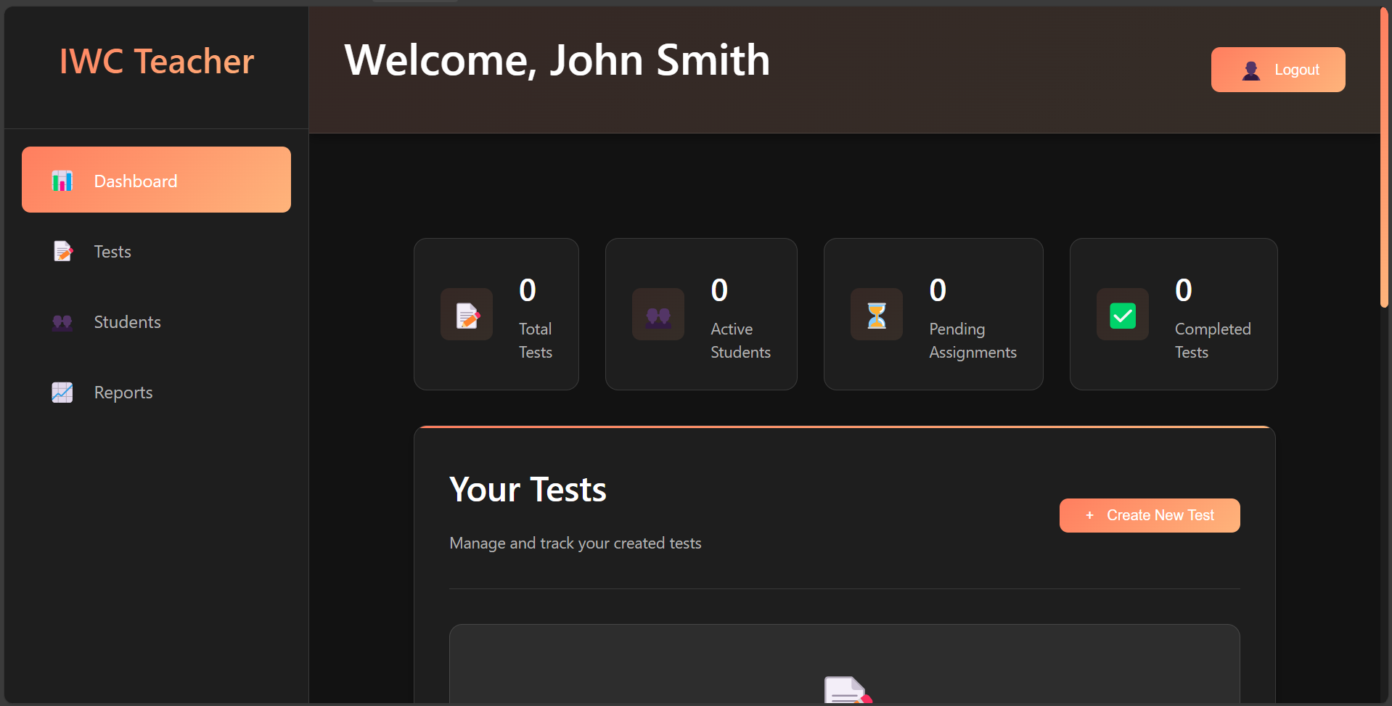



Immigrant Welcome Center
Jacob Shank, Will Denning, Rachel Tebbe, Nathan Szadowski
Butler University EPICS Service Learning – Fall 2024
Team Introduction
Results
Challenges
We created a React JavaScript web application, which uses java to run the PostgreSQL backend. The application currently has functional registration and login for two user types. The application supports signing in by both teachers and students. Both users have a dashboard. Student can view assessments assigned to them by their teachers. Teachers can see the students that are in the system and will eventually be able to see a detailed view of a specific student. The teacher dashboard also has a button for assessment creation, but this feature is not completed.
The application is structured in a three-tier manner, including a frontend, backend, and database. The technology involved in the front end is React as a TypeScript framework. The backend employs Express.js REST API, and for persistence, the database engine is PostgreSQL.
More specifically regarding the frontend, a component library called MaterialUI was used to create a clean looking, easy to use, responsive user interface. This was done with students in mind as navigation could not be achieved through labelling buttons with English words. We needed to facilitate a streamlined experience for English Language Learners.
Along with the elegant frontend, we feel that the back end is very robust. Future groups should only have to do very minimal work with the backend. The backend is fully able to function with both the database and the frontend.
Web development requires a lot of tools and technologies that were brand new to all of us. A number of these tools are not free which created even more development obstacles. These tools have significant documentation. Even with this documentation, however, learning them is very daunting. With some of these tools, we had significant enough issues that we had to completely redirect our efforts. For example, our deployment tools of choice, AWS Amplify has an ongoing issue which has remained unaddressed for multiple years. Learning this, we completely changed direction in both development and deployment. We pivoted from Angular as our JavaScript framework to React. On the deployment side, we switched from AWS Amplify to AWS EC2 along with AWS RDS in the long term. We used Vercel as a short term deployment option. These curveballs thrown at us significantly slowed down development and negated prior work done.
We also faced challenges in starting when we chose to start this project from scratch. This is inherently a challenge because of the intense development decisions that a team faces on the outset of a project. In all likelihood, the team will make multiple bad choices due to a lack of experience, leading to development slowdowns. Not only did the application need to be developed, but the development process had to be researched and learned by the team before significant progress could be made. This is a much more difficult development process than continuing a project on a platform that the team already knows.
Members
Jacob Shank (middle right) – Team Leader
Will Denning (middle left) – Documentation
Rachel Tebbe (left) – UI/UX
Nathan Szadowski (right) - Developer
Client Background and Information
Conclusion/Reflection
This course is very challenging. yet creates unique experience and skills. Working with clients is a unique experience that was new to all of us. This experience was a learning curve especially as our nontechnical clients were very curious about the specifics of our work. We all learned valuable skills in technical communication, as well as managing technical expectations with clients.
This course gives the very real experience of being in over your head as a software developer. Software development is hard. There is no easy way to do it. This course teaches that hard reality and thrives when the student feels like they are in the weeds of new technical skills.
The Immigrant Welcome Center is a nonprofit organization that provides support to non-English speaking immigrants with the goal of integrating them into the Indianapolis community. IWC was founded in 2006 and has grown from just 12 volunteers to a much larger organization that helps and supports hundreds of people each year. We worked with the English language learning assessment team, which is tasked with helping non-English speaking immigrants learn the English language. They accomplish this through assessments focusing on assisting them in reading, writing, speaking, and understanding different elements of American culture. IWC wanted to switch from a paper-based assessment with textual to a online web-based assessment. Our team’s primary contact was Ginger Kosobucki, who is the director of the English language learners assessment team. We had bi-weekly with Ginger and other members of the team to discuss our current progress and our plans for the future.
Objectives
Our team was tasked with creating an application to administer assessments to adult English language learners. The application must have a simple login functionality for both teachers and student. Teachers should be able to view the results from a student's test including their score and which questions were answered incorrectly. The assessment has five levels each with multiple tasks. The application should be built in a manner that allows inclusion of more levels and tasks in the future. The primary focus was implementing the level B assessment. The application must have very simple UI and not utilize any textual instruction. Both of these features help non-English speakers navigate the assessment. The client also wants the application to be accessible and free to use for other organizations around the world.
Acknowledgements
Professor Munirul Haque
- Faculty Member
Ginger Kosobucki,
- Client Contact, IWC ELL Director

